Slide 1

Creating a GitHub Repository: Different Methods Explained

Slide 2




Why Create a GitHub Repository?
Centralized Storage
Version Control & Collaboration
Securely store all your code and project files in one accessible location.
Track changes, revert to previous versions, and collaborate seamlessly with team members.
Accessible Backup
Open Source & Private Support
Your projects are backed up and available from anywhere, anytime, ensuring data safety.
Contribute to the open-source community or maintain private projects with robust control.

Slide 3
Method 1: GitHub Web UI
The GitHub web interface offers the simplest way to create a new repository, perfect for beginners or quick setups.
01
02
03
Navigate to New Repository
Define Repository Details
Set Visibility
Click the "+" icon (top-right corner of any GitHub page) and select "New repository" from the dropdown menu.
Enter a unique repository name and an optional, but recommended, description.
Choose between Public (visible to everyone) or Private (visible only to you and collaborators).
04
05
Initialize with Options
Create Repository
Optionally add a README file for project documentation, a .gitignore to exclude certain files, and a license.
Click the "Create repository" button to finalize and set up your new project space.

Slide 4
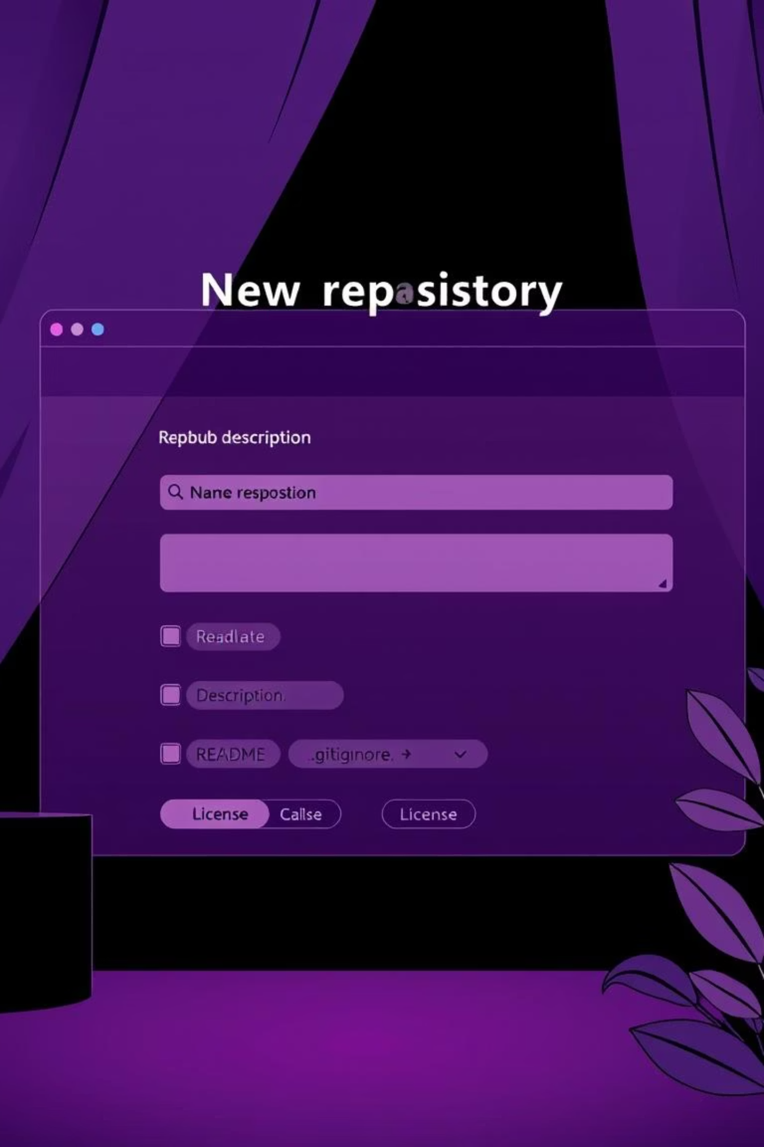
Visual Guide: GitHub's New Repository Page
This image provides a visual overview of the fields you'll encounter when creating a new repository directly on GitHub's website. Pay attention to the highlighted areas for essential information.

Slide 5

Method 2: GitHub CLI (gh)
For developers who prefer working in the terminal, the GitHub CLI offers a powerful and efficient way to manage repositories.
Install GitHub CLI: Ensure you have the GitHub CLI installed on your system. You can find instructions at cli.github.com.
Authenticate Your Session: Open your terminal and run gh auth login to link your CLI to your GitHub account.
Create & Clone New Repo: To create a new public repository and immediately clone it to your local machine, use: gh repo create my-project --public --clone
Remote for Existing Local Repo: If you have a local Git repository and want to create its remote counterpart on GitHub, use: gh repo create my-project --private --source=. --remote=upstream
Push Local Commits: After creating the remote, push your local commits: git push -u main
Using the CLI streamlines your workflow, allowing you to create repositories and manage them without leaving your development environment.

Slide 6

Method 3: Local Git & Push
This method is ideal for projects that already exist locally or for developers who prefer to manage their Git workflow from the command line.
Navigate to Project
Open your terminal and change directory to your existing project folder: cd /path/to/your/project
Initialize Git
Initialize a new Git repository within your project: git init
Add & Commit Files
Add all project files to the staging area: git add . Then commit your changes: git commit -m "Initial commit"
Create Remote Repo
Manually create a new empty repository on GitHub via the web UI (do NOT initialize with README, .gitignore, or license here).
Link Remote
Add the GitHub repository as a remote origin to your local repository: git remote add origin <repo-URL>
Push to GitHub
Push your local main branch to the GitHub repository: git push -u origin main

Slide 7
Essential Tips for Git & GitHub Workflow
Beyond the creation methods, mastering these practices will enhance your repository management:
Use HTTPS for Remote URLs
Personal Access Tokens (PAT)
Opt for the HTTPS URL when adding a remote to avoid complex SSH setup initially, simplifying authentication.
GitHub now mandates Personal Access Tokens (PAT) instead of passwords for command-line operations. Generate one in your GitHub settings for secure pushes.
Always Create a README.md
Utilize .gitignore
A README.md file is crucial for describing your project, its purpose, how to install it, and how to use it. It's the first thing visitors see.
Use a .gitignore file to prevent unnecessary files (like build artifacts, temporary files, or environment configurations) from being committed to your repository.

Slide 8


Ready to Create Your First Repository?
Embark on your journey into version control and collaboration today!
Start Now
Deepen Your Mastery
Visit github.com/new to begin creating your first repository immediately.
Explore GitHub's comprehensive documentation and CLI tutorials for advanced usage.
Join the Community
Build Your Legacy
Connect with fellow developers and get support from the vibrant GitHub Community.
Your code's new home awaits! Start pushing your ideas and projects to the world.

